Slide 1
Quantum computing is dead
@LlewellynFalco

Slide 2
Quantum computing is alive
@LlewellynFalco

Slide 3
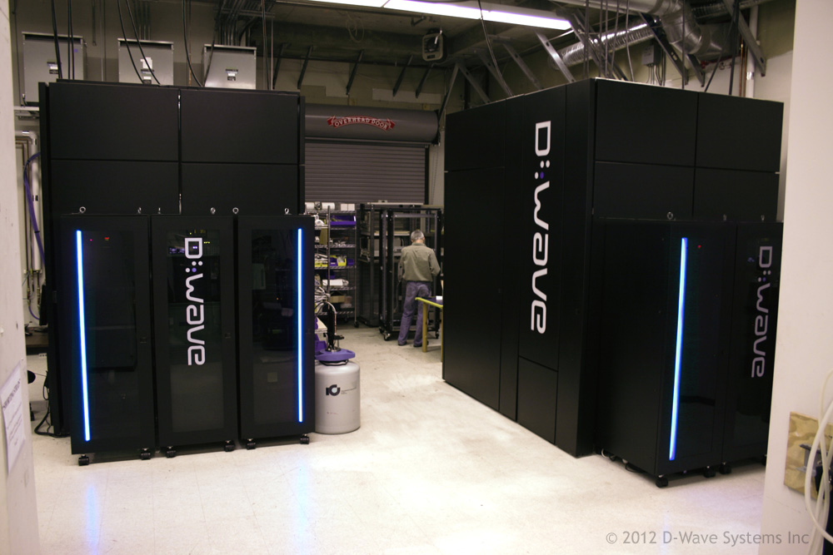

Slide 4
Brute Force Combinatorics

Slide 5
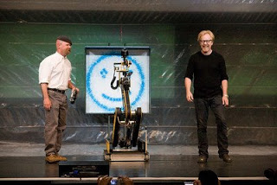
CPU

Slide 6
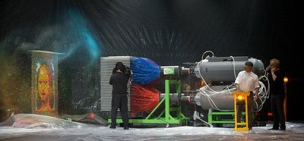
GPU

Slide 7
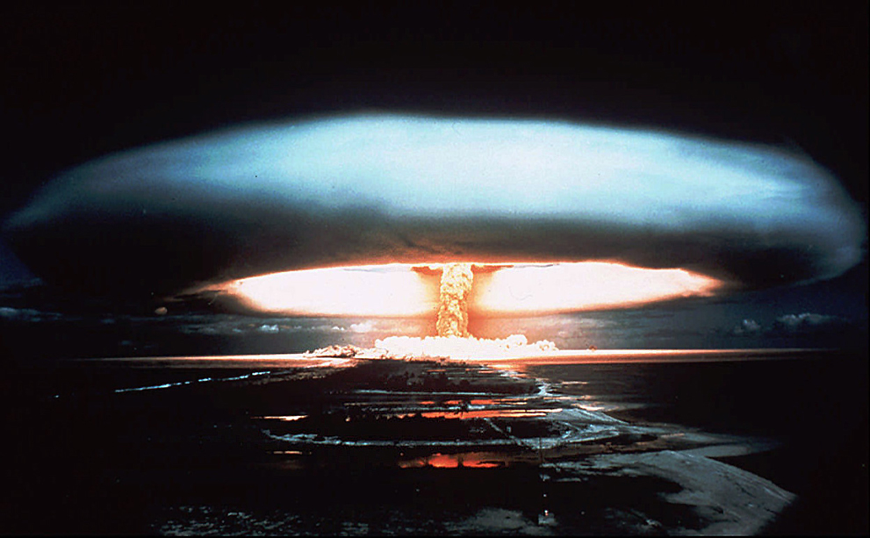
Quantum
3,000,000,000,000
,000,000,000,000
,000,000,000,000
,000,000,000,000

Slide 8
Prime Factors

Slide 9
What are the prime factors of 43143988327398957279342419750374600193 ?

Slide 10
Does 32753465664812 * 1432432534762432 = 43143988327398957279342419750374600193 ?

Slide 11
1st
2nd

Slide 12
Probability Calculate(Bit[] scenario)

Slide 13
Probability Calculate(Bit[] scenario)
{
var myScenario = Transform(scenario);
Return CalculateFor(myScenario);
}

Slide 14
6 QuBIT Example

Slide 15
What are the prime factors of 35?

Slide 16
1st
2nd

Slide 17
1st
2nd
5
7

Slide 18
✔
1st
2nd
5
x
7
= 35
✗

Slide 19
1st
2st
000
001
010
011
000
001
010
011
100
101
5
110
111
100
101
110
111
7

Slide 20
000000
000001
000010
000011
000100
000101
000110
000111
001000
001001
001010
001011
001100
001101
001110
001111
010000
010001
010010
010011
010100
010101
010110
010111
011000
011001
011010
011011
011100
011101
011110
011111
100000
100001
100010
100011
100100
100101
100110
100111
101000
101001
101010
101011
101100
101101
101110
101111
110000
110001
110010
110011
110100
110101
110110
100111
111000
111001
111010
111011
111100
111101
111110
111111

Slide 21
000000
000001
000010
000011
000100
000101
000110
000111
001000
001001
001010
001011
001100
001101
001110
001111
010000
010001
010010
010011
010100
010101
010110
010111
011000
011001
011010
011011
011100
011101
011110
011111
100000
100001
100010
100011
100100
100101
100110
100111
101000
101001
101010
101011
101100
101101
101110
101111
110000
110001
110010
110011
110100
110101
110110
100111
111000
111001
111010
111011
111100
111101
111110
111111

Slide 22
128 Qubits = 2^128 = 3.4E38 = 340,282,370,000,000,000,000, 000,000,000,000,000,000

Slide 23
Platform as a service

Slide 24
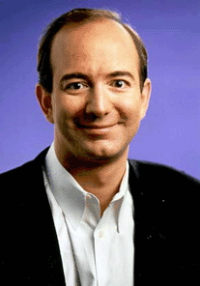
Jeff Bezos

